Slide 1
Information Retrival Project
– Neural Networks in Information Retrival –
Flavia De Santis
A.A. 2023/2024

Slide 2
Theory:
Definition of Text Retrieval Tasks
Text Representation with NN
Deep NN for IR: Architectures and Techniques
Project:
Dataset (from Kaggle)
Pre-processing and implementing a CNN-based Model
Implementation Details
IR task
  Query
  Reviews ranking
Conclusions

Slide 3
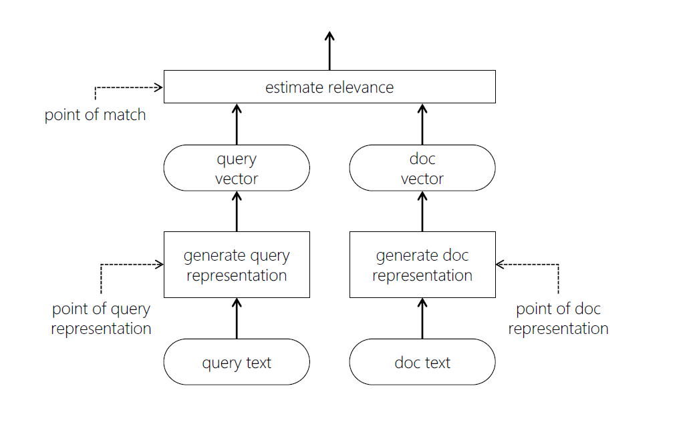
Theory
Definition of Text Retrival Task
Ad-hoc retrieval
Question-answering
Neural Networks
Desiderata
Semantic understanding
Robustness to …
Sensitivity to context
Efficiency
Source: Mitra and Craswell (2018)
Document ranking typically involves a query and a document representation steps, followed by a matching stage. Neural models can be useful either for generating good representations or in estimating relevance, or both.

Slide 4
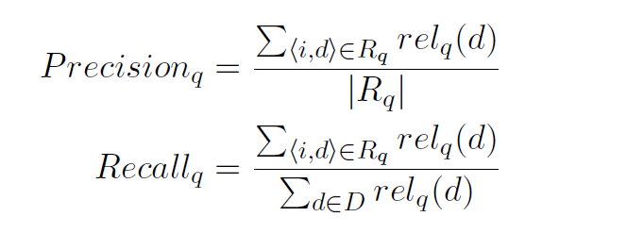
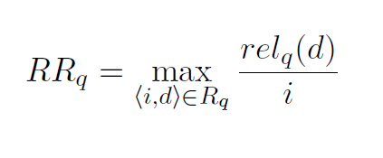
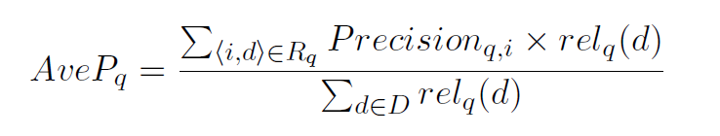
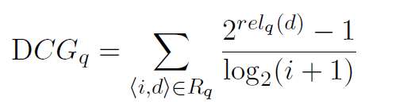
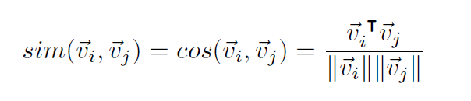
Definition of Text Retrival Task (2)
Metrics
Traditional IR models
BM25
LM
Dependence model
Translation models
PRF
# of query term occurrences in the document
phrasal matches
vocabulary mismatch bw query and document
COSINE SIMILARITY

Slide 5
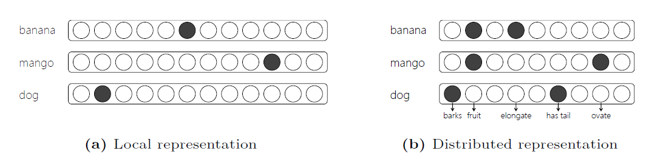
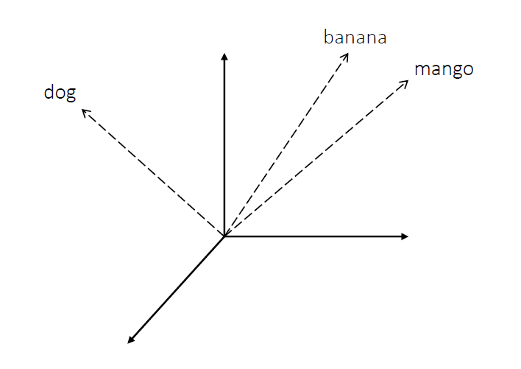
Text Representation with Neural Networks
Each term can be represented within a neural network by the activation of a single neuron (local representation) or by the pattern of activations of several neurons (distributed representation)
Source: Mitra and Craswell (2018)

Slide 6
Text Representation with Neural Networks (2)
Observed feature spaces
An embedding is a representation of items in a new space s.t. the original representation’s properties of the items are preserved
SPARSE
vs
DENSE
Latent feature spaces
Latent Semantic Analysis
(LSA)
Probabilistic LSA (PLSA)
Word2vec
GloVe
Paragraph2vec
Neural IR models can influence
the query representation
the document representation
the relevance estimation
5

Slide 7
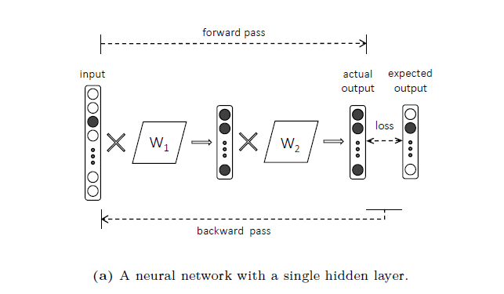
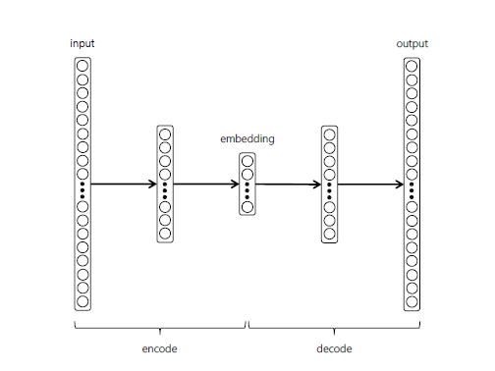
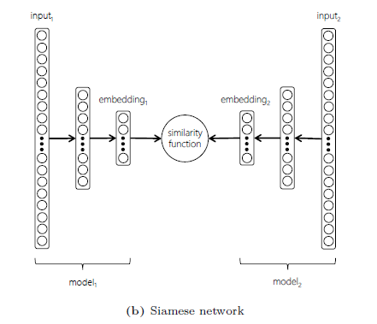
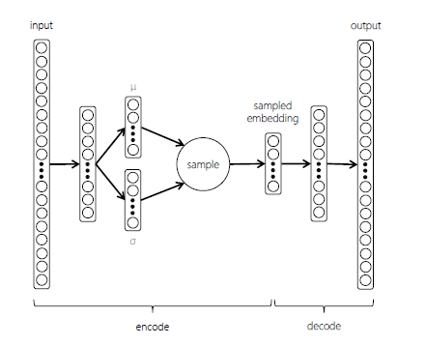
Deep Neural Networks for IR: Architectures and Techniques
compressed representations of inputs
Feed-forward neural network with a single hidden layer.
AUTOENCODER
SIAMESE NETWORK
Source: Mitra and Craswell (2018)
VARIATIONAL AUTOENCODER

Slide 8
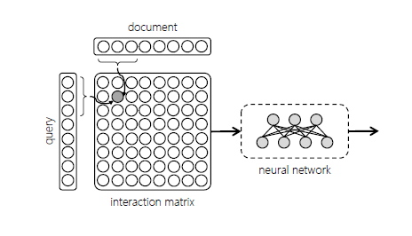
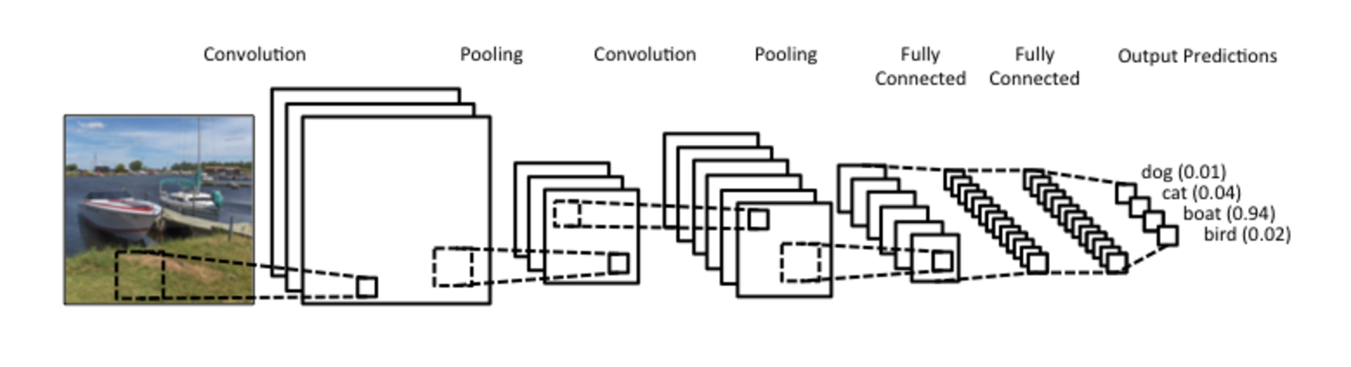
Deep Neural Networks for IR: Architectures and Techniques (2)
Interaction matrix generated by comparing windows of text from the query and the document. A DNN operates over the interaction matrix to find patterns of matches that suggest relevance of the document to the query.

Slide 9
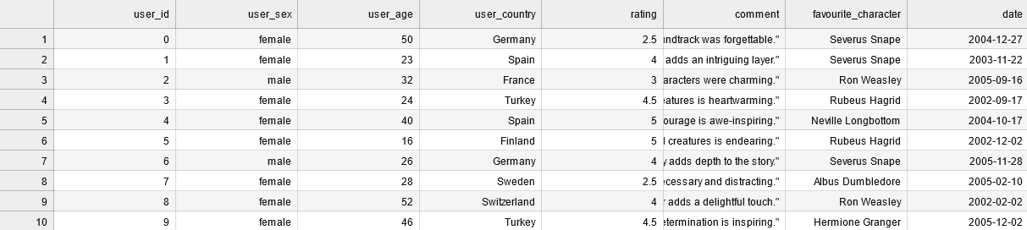
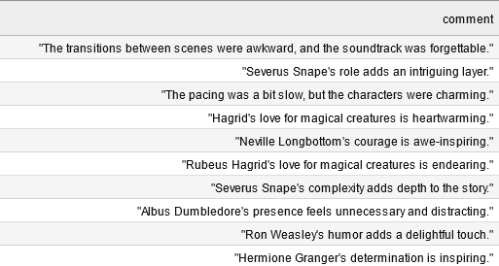
Project
Dataset (from Kaggle)
…
…

Slide 10
Project
Dataset
…
10

Slide 11
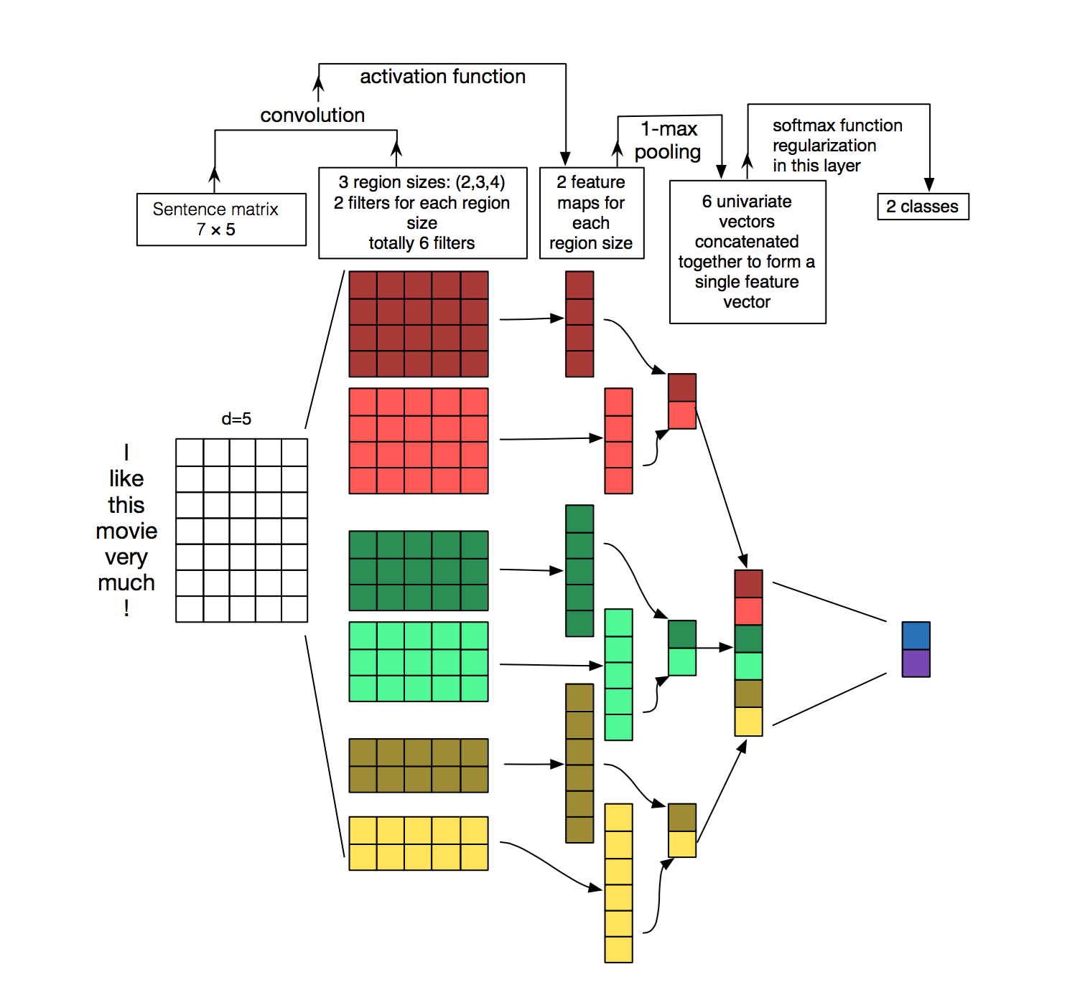
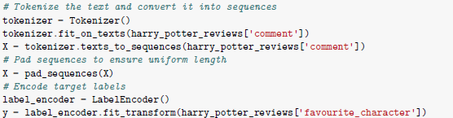
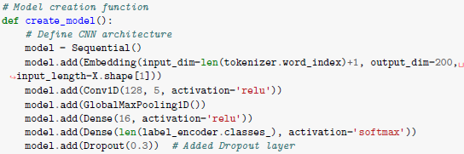

Pre-processing and implementing a CNN-based Model
Pre-processing
Implementing the model
Source: Zhang, Y., & Wallace, B. (2015)

Slide 12
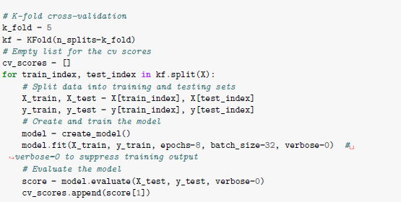
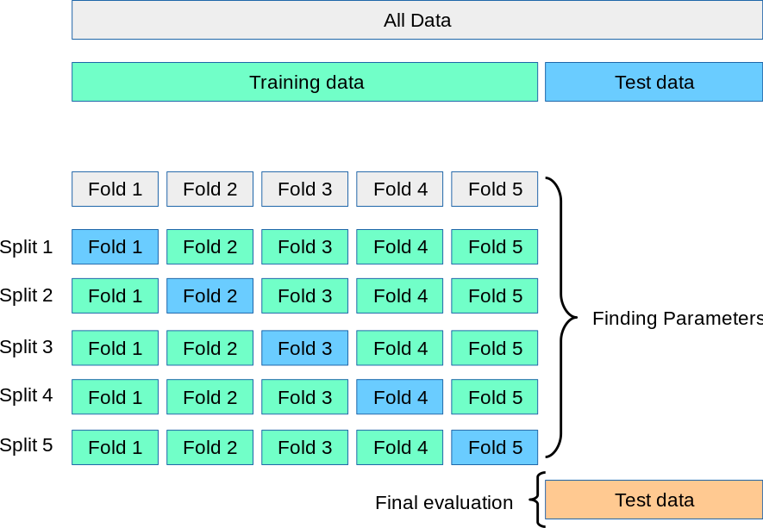
Implementation Details
Source: Sklearn

Slide 13
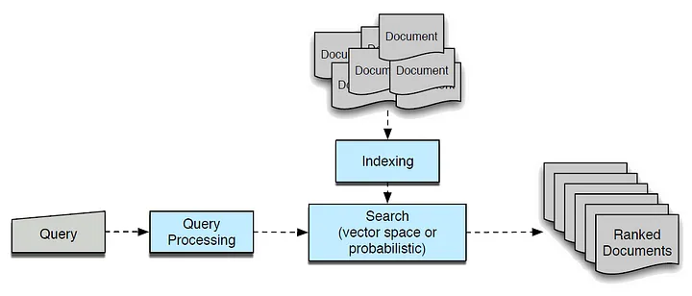
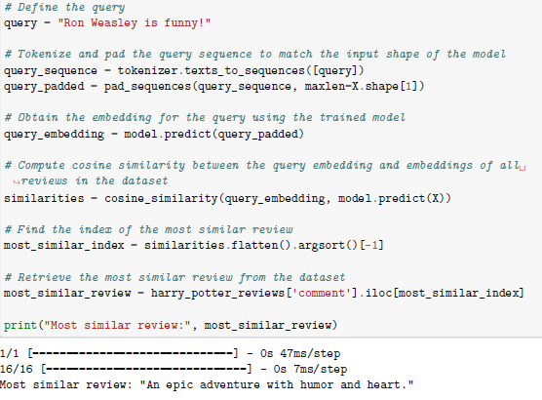
IR task: query
Source: medium.com
14

Slide 14
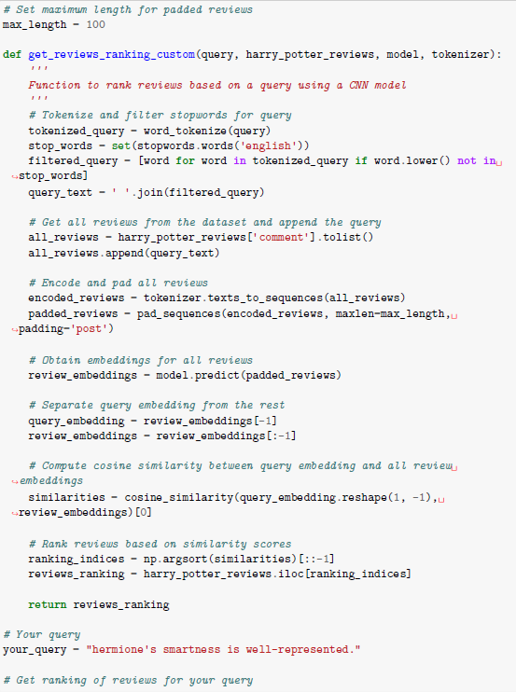
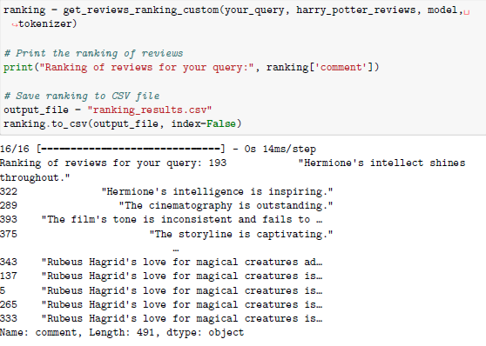
IR task: reviews ranking
13

Slide 15
Conclusions
A DNN with a large set of parameters can easily overfit to smaller training datasets (Zhang et al., 2016). Therefore, during model design it is typical to strike a balance between the number of model parameters and the size of the data available for training.
  In this case, K-fold cross-validation, keeping the model shallow (reducing the number of neurons) and iperparameter tuning helped the model to generalize.
Some metrics could have been applied during the evaluation phase of the ranking task (as they have been after the classification task performed to test the model) if we had a query relevance labels for each comment.
Other model architectures can fit on the specific problem, although CNNs are usually a good choice.

Slide 16
Kaggle.com
Manning, C. D., Raghavan, P., Schütze, H. (2008), “Introduction to Information Retrieval, Cambridge University Press, ISBN: 0521865719
Mitra, B., Craswell, N., (2018), “An Introduction to Neural Information Retrieval”, : Vol. xx, No. xx, pp 1–18. doi: 10.1561/XXXXXXXXX
Newatia, R. (2019), “How to implement CNN for NLP tasks like Sentence Classification”, medium.com/saarthi-ai/sentence-classification-using-convolutional-neural-networks-ddad72c7048c
Shen, Y.; He, X.; Gao, J.; Deng, L.; Mesnil, G. (2014) [ACM Press the 23rd ACM International Conference - Shanghai, China (2014.11.03-2014.11.07)] Proceedings of the 23rd ACM International Conference on Conference on Information and Knowledge Management - CIKM “14 - A Latent Semantic Model with Convolutional-Pooling Structure for Information Retrieval.”, 101–110. doi:10.1145/2661829.2661935
Zhang, Y., & Wallace, B. (2015), “A Sensitivity Analysis of (and Practitioners’ Guide to) Convolutional Neural Networks for Sentence Classification”

